Slide 1
Container Terminal
Group - 12

Slide 2
Group Members
Rupesh Garg 19IM30019
Utsav Kumar Patel 19IM30021
Vadthya Sanjay Kumar 19IM30022
Yomesh Yadav 19IM30024
Mridul Gupta 19IM30025

Slide 3
Problem Statement
One of the country’s biggest container terminal is situated in South India. Large number of containers arrive by ships to this container terminal every week. Handling and storing these arrived container is to be done by the terminal staff. Develop a model to simulate the storing and handling of containers in the container terminal. Consider the container arrival rate, time to unload the containers from the vessel, storage facility like storage capacity etc. in the model. Apply both discrete and continuous simulation methodologies and compare the results.

Slide 4

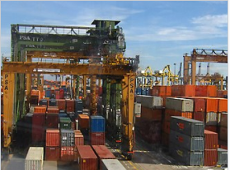
INTRODUCTION
Results
A container terminal is a facility where cargo containers are transhipped between different transport vehicles for onward transportation.
Chennai Port Tamil Nadu is the largest port in the South India. Hence we have collected data of that port only for our model.

Slide 5
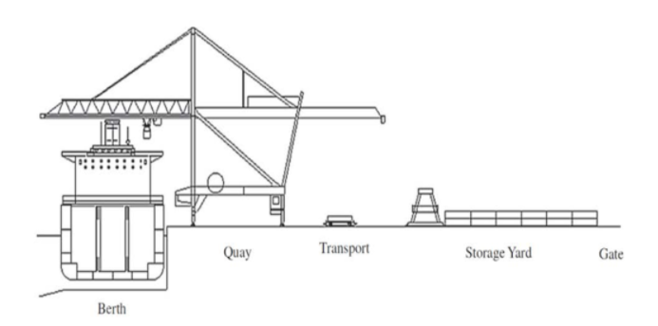
Picture Visualization of the Model

Slide 6
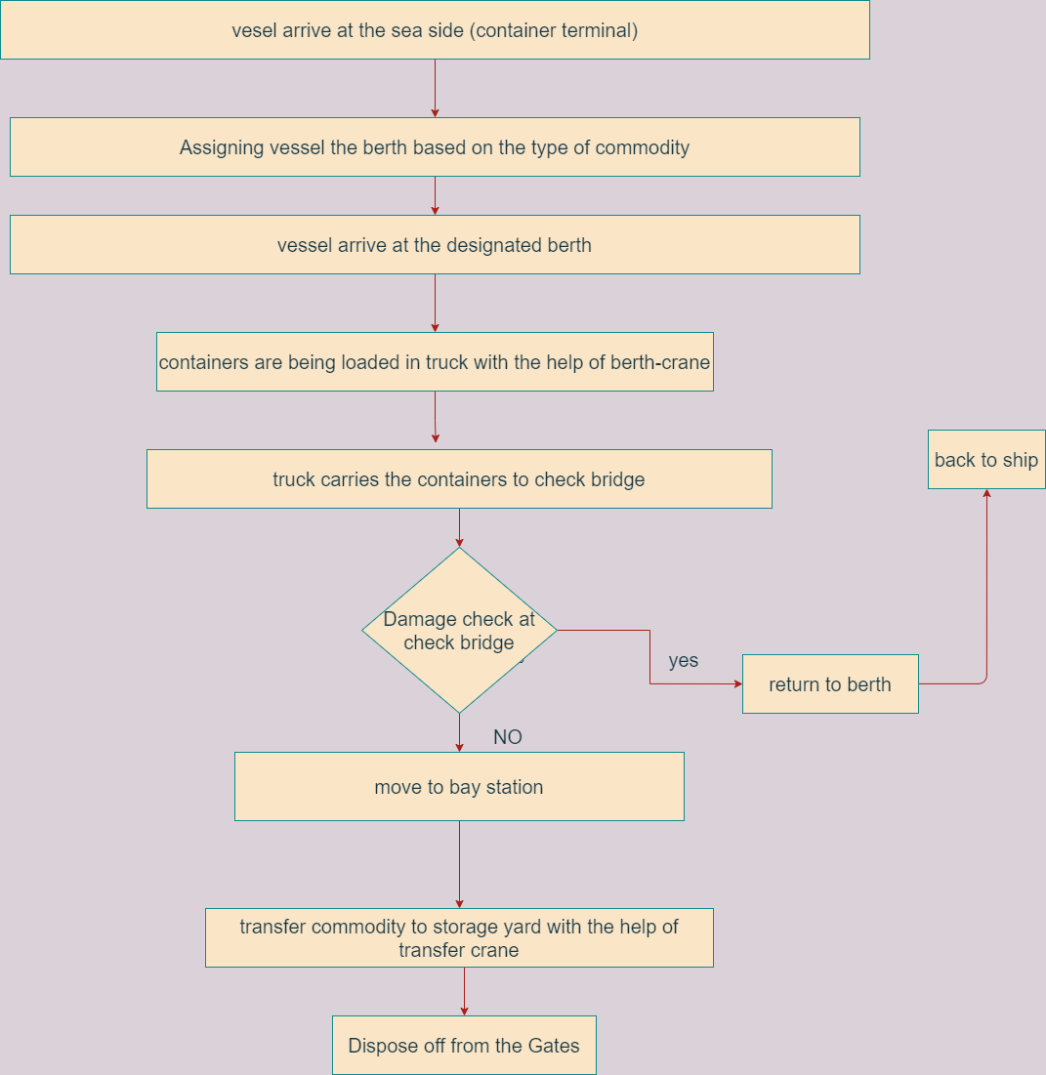
Flowchart-

Slide 7
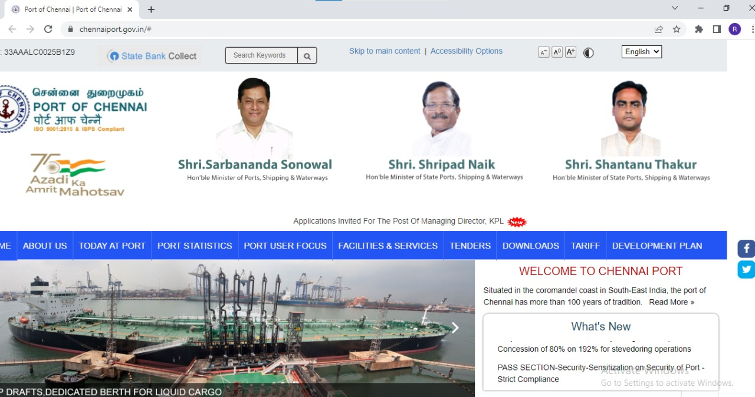
Data References
https://www.chennaiport.gov.in/#

Slide 8
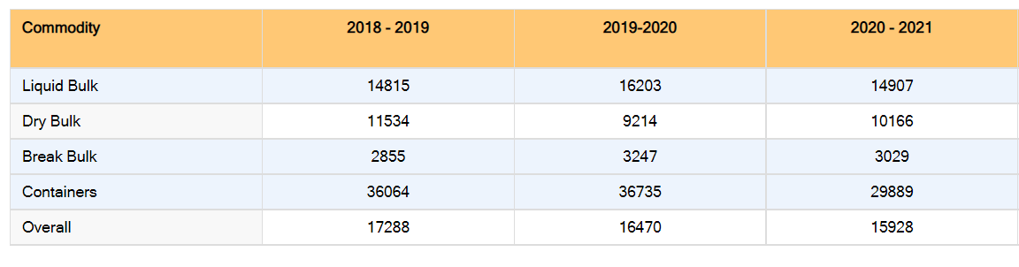
Data
Average Ship Birth Output – In tonnes

Slide 9
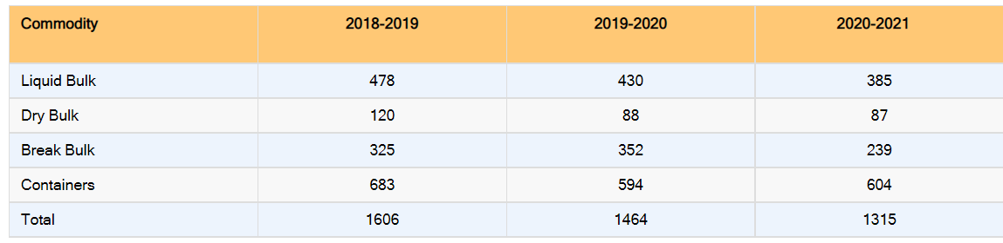
Data
Vessels Handled in Numbers

Slide 10
Data
Probability of Arrival of each commodity
Commodity | Probability
Liquid Bulk | 0.293
Dry Bulk | 0.066
Break Bulk | 0.182
Containers | 0.459

Slide 11
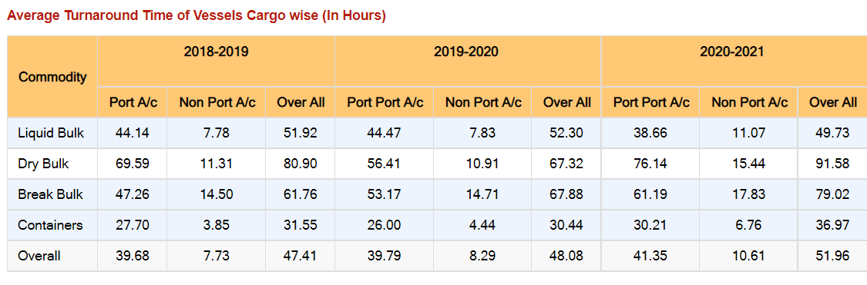
Data
Average Turnaround Time of Vessels Commodity wise (in hours)

Slide 12
Berth Assignment to Commodities
Berth | Commodity
North Quay | Liquid Bulk
West Quay I | Liquid Bulk
West Quay II | Liquid/Break Bulk
West Quay III | Break Bulk
West Quay IV | Break Bulk
Centre Quay | Break Bulk
South Quay I | Break/Dry Bulk
South Quay II | Break/Dry/Liquid Bulk
Second Container Berth I | Containers
Second Container Berth II | Containers
Second Container Berth III | Containers

Slide 13
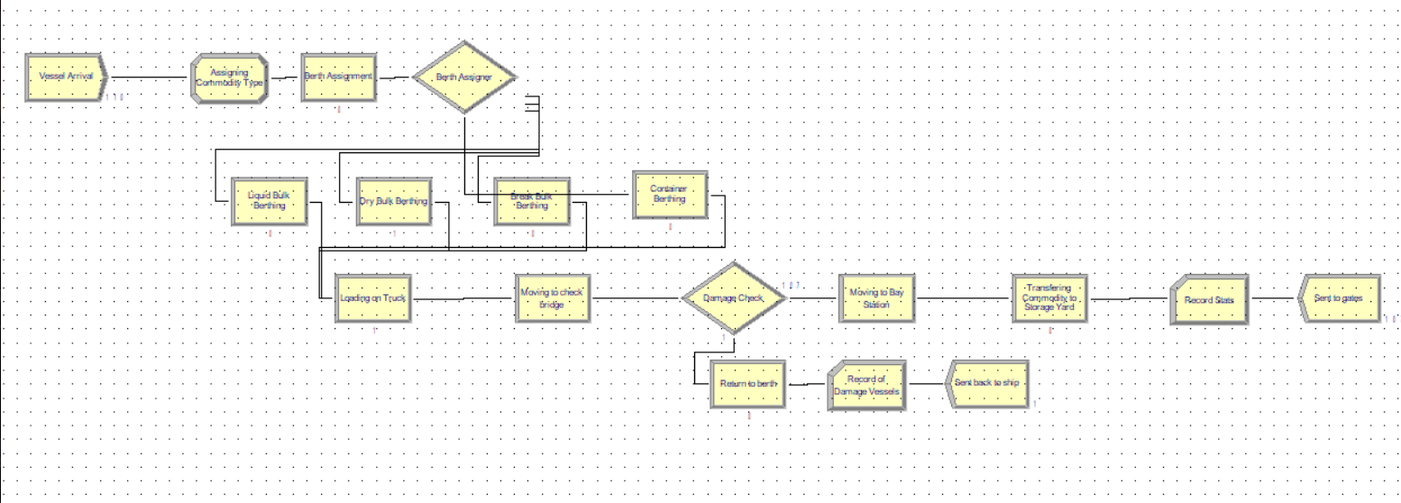
Results
Model

Slide 14
Results and Conclusions
Results
Average number of batches of containers IN is 110.
Average number of batches of containers stored in storage yard is 108.
Average number of batches of containers in WIP is 1.
Average number of batches of damaged containers is 1.
Total Average Time of one batch of container in system is 7.01 hours.

Slide 15
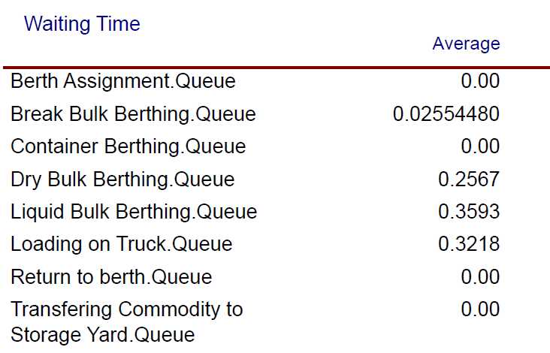
Waiting Time in Queue

Slide 16
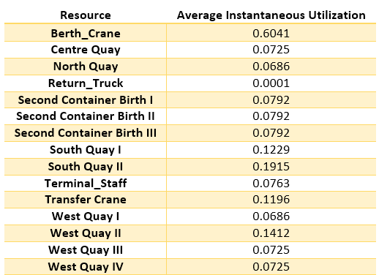
Instantaneous Utilization
Results
Instantaneous Utilization of Berth Crane is highest as it will be transferring the containers from all four berths to truck.
Instantaneous Utilization of South Quay II is second highest as it can take liquid, dry as well as break bulk also. Hence it is used very often.
Instantaneous Utilization of West Quay II is second highest as it can take liquid as well as break bulk also.

Slide 17
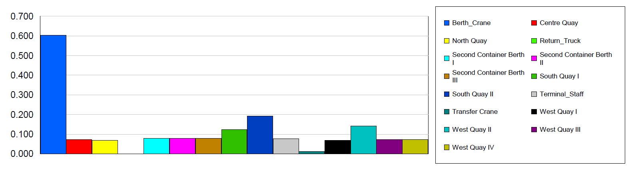
Results
Instantaneous Utilization

Slide 18
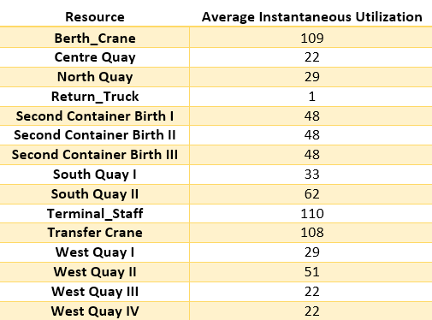
Results
Total Number Seized
It can be seen that the 110 batches of container has been seized by terminal staff.
Out of which 109 has been passed through the damage check.
108 has been stored in store yard and 1 has been returned as it is found to be damaged.

Slide 19
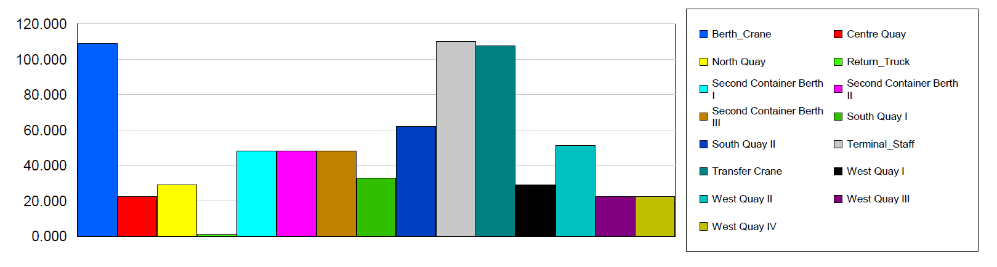
Results
Total Number Seized

Slide 20
Results
Thank You!!

